Slide 1
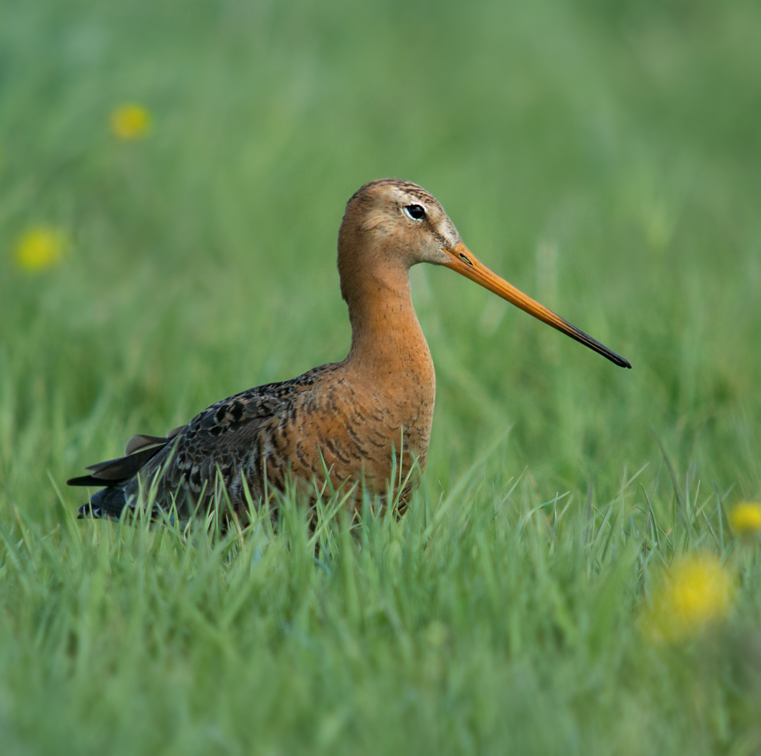
#BOUsci23 - Sample Slide
Keep this area empty.
16:9 Aspect ratio
Keep it simple
Be colour-blind-aware – see presenter guidelines
Use pictures and clear
figures
Include your social
media details
Keep this area empty if you are using closed captions

